Slide 1
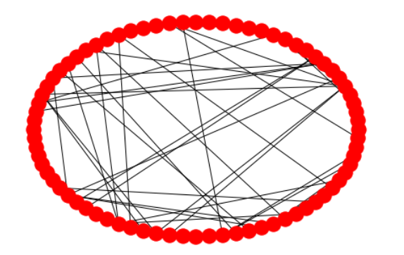
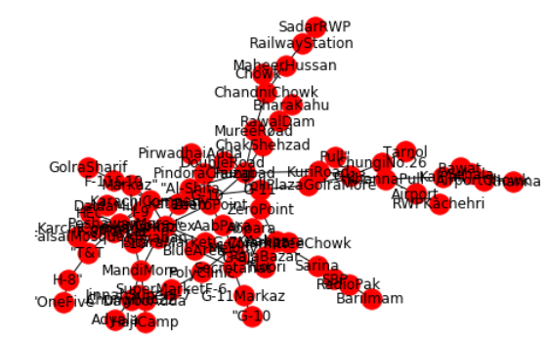
RAWALPINDI BUS ROUTES
Introduction:
Collection of Data:
The Graph focuses on the buses travelling through various routes. The nodes are the bus stops and the edges represents/act the way/path b/w these nodes.
We used Wikipedia to collect our data.
Number of Nodes | Number of Edges | Average Degree
76 This signifies that we took 76 bus stops ). | 85 This signifies that the connection between those 76 stops were measured to be 85. | 2.23 At average a bus stop is connected with 2.23 bus stops
Group Members:
MAJZOOB E ALI
DANIYAL ASLAM
HAMMAS BIN HUSSAIN
(18b-066-se)
(18b-114-se)
(18b-039-se)

